Slide 1
William Stallings
Computer Organization and Architecture
8th Edition
Chapter 9
Computer Arithmetic

Slide 2
Arithmetic & Logic Unit
Does the calculations
Everything else in the computer is there to service this unit
Handles integers
May handle floating point (real) numbers
May be separate FPU (maths co-processor)
May be on chip separate FPU (486DX +)

Slide 3
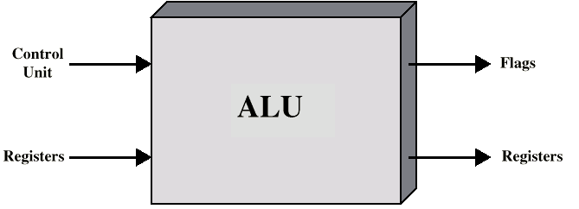
ALU Inputs and Outputs

Slide 4
Integer Representation
Only have 0 & 1 to represent everything
Positive numbers stored in binary
  e.g. 41=00101001
No minus sign
No period
Sign-Magnitude
Two’s compliment

Slide 5
Sign-Magnitude
Left most bit is sign bit
0 means positive
1 means negative
+18 = 00010010
-18 = 10010010
Problems
  Need to consider both sign and magnitude in arithmetic
  Two representations of zero (+0 and -0)

Slide 6
Two’s Compliment
+3 = 00000011
+2 = 00000010
+1 = 00000001
+0 = 00000000
-1 = 11111111
-2 = 11111110
-3 = 11111101

Slide 7
Benefits
One representation of zero
Arithmetic works easily (see later)
Negating is fairly easy
  3 = 00000011
  Boolean complement gives 11111100
  Add 1 to LSB 11111101

Slide 8
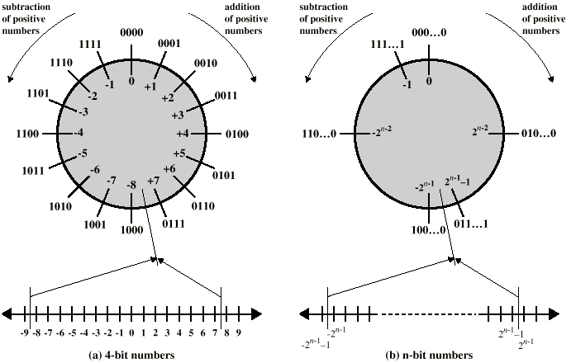
Geometric Depiction of Twos Complement Integers

Slide 9
Negation Special Case 1
0 = 00000000
Bitwise not 11111111
Add 1 to LSB +1
Result 1 00000000
Overflow is ignored, so:
- 0 = 0 √

Slide 10
Negation Special Case 2
-128 = 10000000
bitwise not 01111111
Add 1 to LSB +1
Result 10000000
So:
-(-128) = -128 X
Monitor MSB (sign bit)
It should change during negation

Slide 11
Range of Numbers
8 bit 2s compliment
  +127 = 01111111 = 2⁷ -1
  -128 = 10000000 = -2⁷
16 bit 2s compliment
  +32767 = 011111111 11111111 = 2¹⁵ - 1
  -32768 = 100000000 00000000 = -2¹⁵

Slide 12
Conversion Between Lengths
Positive number pack with leading zeros
+18 = 00010010
+18 = 00000000 00010010
Negative numbers pack with leading ones
-18 = 10010010
-18 = 11111111 10010010
i.e. pack with MSB (sign bit)

Slide 13
Addition and Subtraction
Normal binary addition
Monitor sign bit for overflow
Take twos compliment of substahend and add to minuend
  i.e. a - b = a + (-b)
So we only need addition and complement circuits

Slide 14
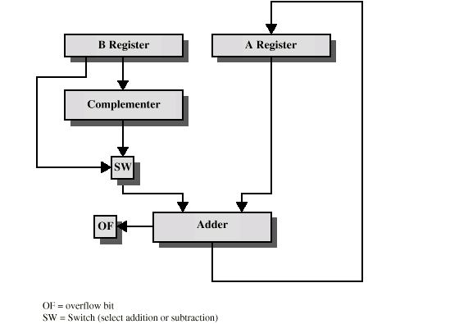
Hardware for Addition and Subtraction

Slide 15
Multiplication
Complex
Work out partial product for each digit
Take care with place value (column)
Add partial products

Slide 16
Multiplication Example
1011 Multiplicand (11 dec)
x 1101 Multiplier (13 dec)
1011 Partial products
0000 Note: if multiplier bit is 1 copy
1011 multiplicand (place value)
1011 otherwise zero
10001111 Product (143 dec)
Note: need double length result

Slide 17
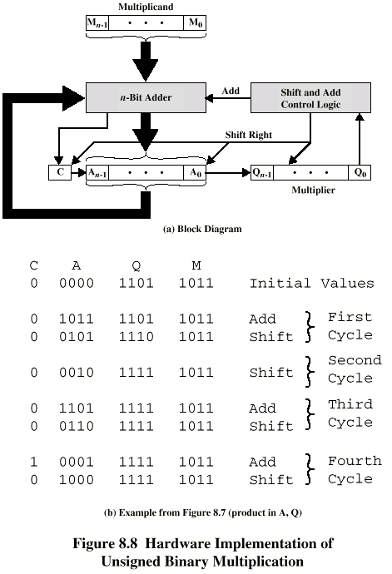
Unsigned Binary Multiplication
Initially A & C are all zeroes. Thick arrows: word copy. Thin left, up & down arrows: bit copy. Thin slanted & right arrows: control command.

Slide 18
Execution of Example

Slide 19
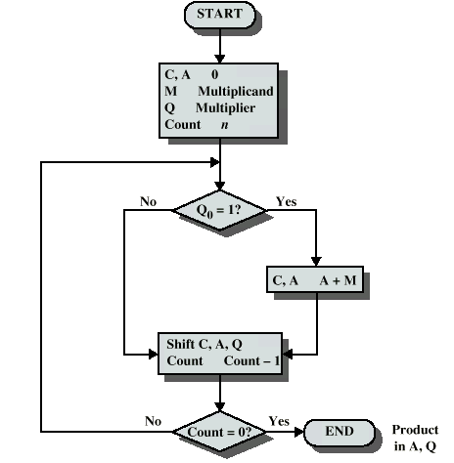
Flowchart for Unsigned Binary Multiplication

Slide 20
Multiplying Negative Numbers
This does not work!
Solution 1
  Convert to positive if required
  Multiply as above
  If signs were different, negate answer
Solution 2
  Booth’s algorithm

Slide 21
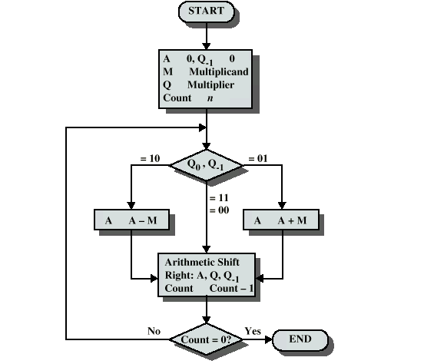
Booth’s Algorithm

Slide 22
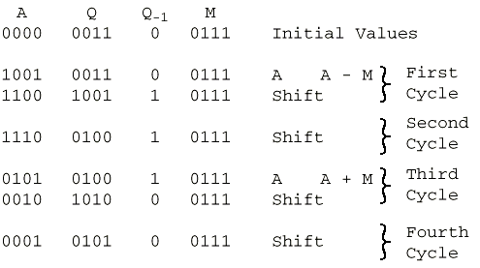
Example of Booth’s Algorithm

Slide 23
Division
More complex than multiplication
Negative numbers are really bad!
Based on long division

Slide 24
Division of Unsigned Binary Integers
00001101
Quotient
Divisor
1011
10010011
Dividend
1011
001110
Partial
Remainders
1011
001111
1011
Remainder
100

Slide 25
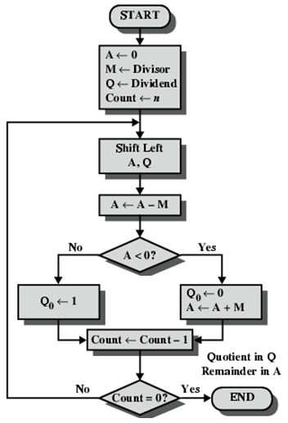
Flowchart for Unsigned Binary Division

Slide 26
Real Numbers
Numbers with fractions
Could be done in pure binary
    1001.1010 = 2³ + 2⁰ +2⁻¹ + 2⁻³ =9.625
Where is the binary point?
Fixed?
  Very limited
Moving?
  How do you show where it is?

Slide 27
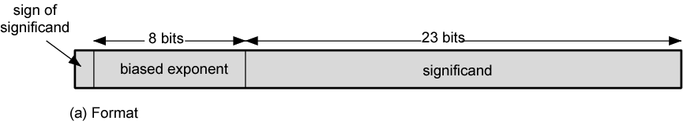
Floating Point
+/- .significand x 2^{exponent}
Misnomer
Point is actually fixed between sign bit and body of mantissa
Exponent indicates place value (point position)

Slide 28
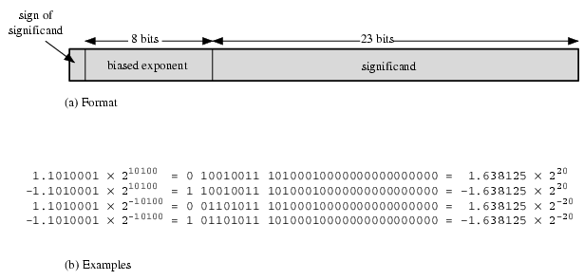
Floating Point Examples

Slide 29
Signs for Floating Point
Mantissa is stored in 2s compliment
Exponent is in excess or biased notation
  e.g. Excess (bias) 128 means
  8 bit exponent field
  Pure value range 0-255
  Subtract 128 to get correct value
  Range -128 to +127

Slide 30
Normalization
FP numbers are usually normalized
i.e. exponent is adjusted so that leading bit (MSB) of mantissa is 1
Since it is always 1 there is no need to store it
(c.f. Scientific notation where numbers are normalized to give a single digit before the decimal point
e.g. 3.123 x 10³)

Slide 31
FP Ranges
For a 32 bit number
  8 bit exponent
  +/- 2²⁵⁶ ≈ 1.5 x 10⁷⁷
Accuracy
  The effect of changing lsb of mantissa
  23 bit mantissa 2⁻²³ ≈ 1.2 x 10⁻⁷
  About 6 decimal places

Slide 32
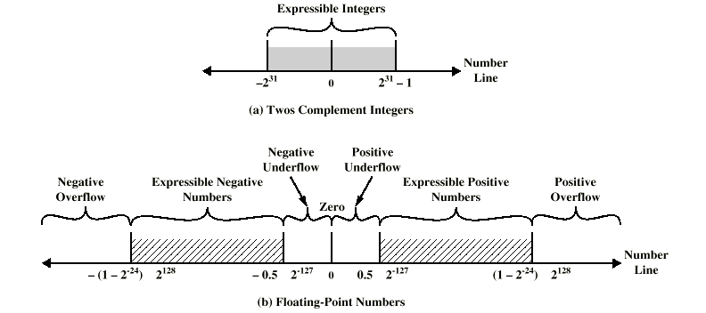
Expressible Numbers

Slide 33
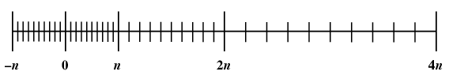
Density of Floating Point Numbers

Slide 34
IEEE 754
Standard for floating point storage
32 and 64 bit standards
8 and 11 bit exponent respectively
Extended formats (both mantissa and exponent) for intermediate results

Slide 35
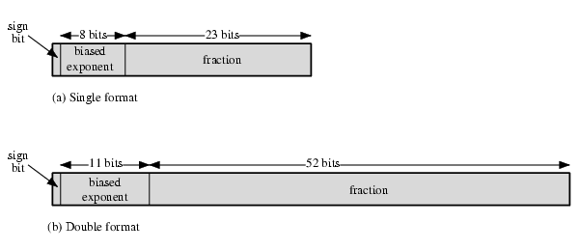
IEEE 754 Formats

Slide 36
FP Arithmetic +/-
Check for zeros
Align significands (adjusting exponents)
Add or subtract significands
Normalize result

Slide 37
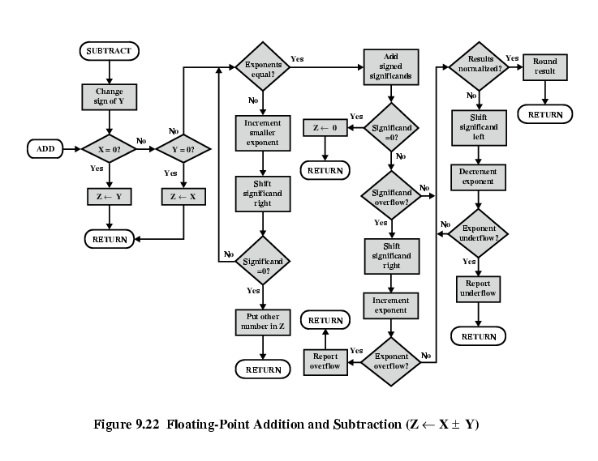
FP Addition & Subtraction Flowchart

Slide 38
FP Arithmetic x/÷
Check for zero
Add/subtract exponents
Multiply/divide significands (watch sign)
Normalize
Round
All intermediate results should be in double length storage

Slide 39
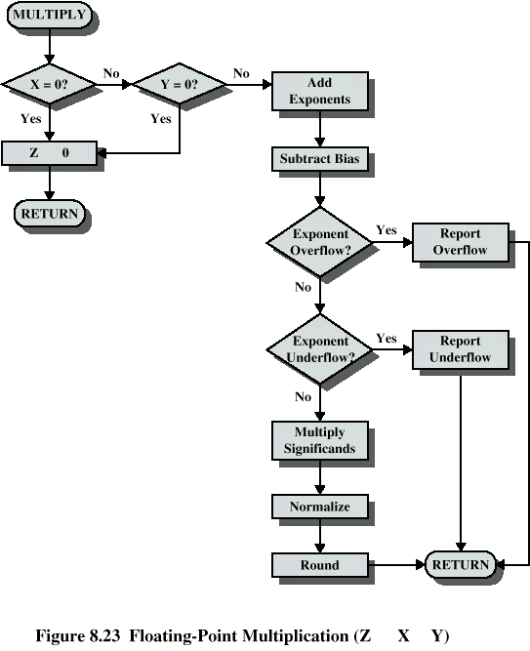
Floating Point Multiplication

Slide 41
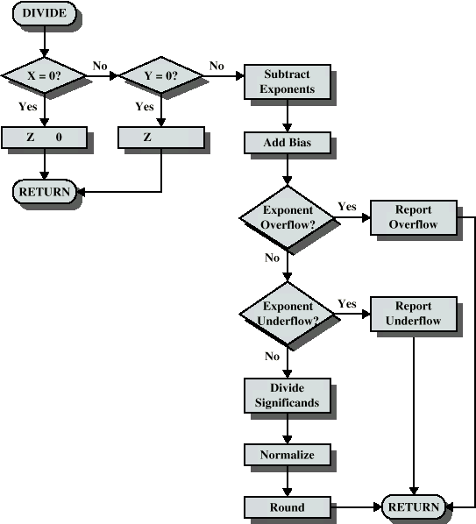
Floating Point Division

Slide 42
Required Reading
Stallings Chapter 9
IEEE 754 on IEEE Web site

